Slide 1
BASKETBALL
TRAINING CENTER
INFOGRAPHICS
Here is where this template begins

Slide 2
BASKETBALL TRAINING CENTER
This template contains an assortment of complementary infographic resources for the Basketball Training Center presentation
These infographics are adapted to the style of the aforementioned presentation, so you can insert them easily and have them completely integrated at once. You just need to do the following:
Select the element that you want to copy
Right-click and choose “Copy”
Go to the slide where you want the element to appear
Right-click and choose “Paste

Slide 3
BASKETBALL TRAINING CENTER
4/5
2/5
5/5
JUPITER
VENUS
MARS
Jupiter is an enormous planet
Venus has a beautiful name
Mars is full of iron oxide dust
It’s a gas giant
It’s terribly hot
It’s a cold place

Slide 4
BASKETBALL TRAINING CENTER
01
JUPITER
Jupiter is the biggest planet of them all
20%
02
VENUS
Venus is the second planet from the Sun
50%
03
NEPTUNE
It is the farthest planet from the Sun
70%

Slide 5
BASKETBALL TRAINING CENTER
40%
It’s terribly hot
VENUS
Venus is the second planet from the Sun
JUPITER
Jupiter is the biggest planet of them all
It’s a gas giant
60%

Slide 6
BASKETBALL TRAINING CENTER
22%
33%
01
03
Venus has a beautiful name
Mercury is quite a small planet
80%
60%
02
04
Jupiter is an enormous planet
Mars is actually a cold place

Slide 7
BASKETBALL TRAINING CENTER
JUPITER
MERCURY
Jupiter is a gas giant and the biggest planet in the Solar System
01
Mercury is the closest planet to the Sun and the smallest of them all
02
VENUS
MARS
03
04
Venus has a beautiful name and is the second planet from the Sun
Despite being red, Mars is actually a cold place. It’s full of iron oxide dust

Slide 8
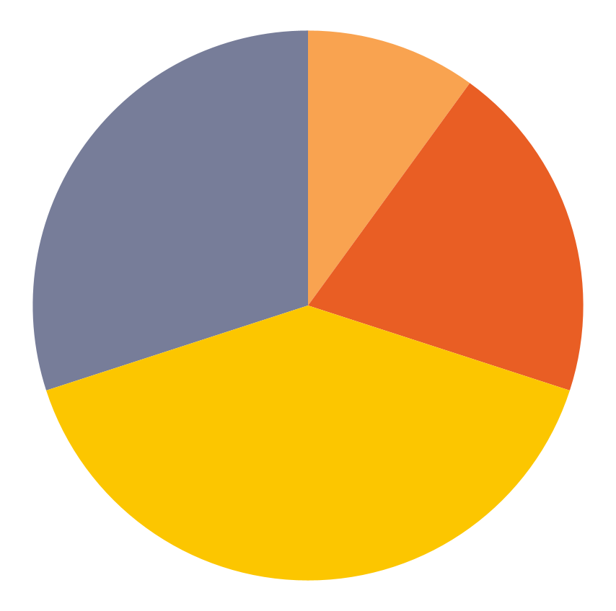
BASKETBALL TRAINING CENTER
Training | Percentage
A | 10%
B | 20%
C | 40%
D | 30%
Mercury is the closest planet to the Sun and the smallest one in the entire Solar System. This planet's name has nothing to do with the liquid metal
Follow the link in the graph to modify its data and then paste the new one here. For more info, click here

Slide 9
BASKETBALL TRAINING CENTER
MERCURY
01
Mercury is quite a small planet
JUPITER
It’s the biggest planet of them all
MARS
Earth is the third planet from the Sun
Mars is actually a very cold place
02
VENUS
SATURN
Venus has a beautiful name
Saturn is a gas giant and has rings

Slide 10
BASKETBALL TRAINING CENTER
CONCLUSIONS
Mercury is the closest planet to the Sun and the smallest one in the entire Solar System. This planet's name has nothing to do with the liquid metal, since Mercury was named after the Roman messenger god. Mercury has no natural satellites
12 million players in total!
Children
Teens
Adults

Slide 11
BASKETBALL TRAINING CENTER
JUPITER
MERCURY
Jupiter is the biggest planet of them all
Mercury is quite a small planet
EARTH HARBORS LIFE
VENUS
MARS
Venus is the second planet from the Sun
Mars is actually a very cold place

Slide 12
BASKETBALL TRAINING CENTER
03
JUPITER
It’s the biggest planet of them all
02
VENUS
Venus has a beautiful name
01
SATURN
It’s a gas giant and has rings

Slide 13
BASKETBALL TRAINING CENTER
Letter | Name | Measurements
A | Venus | 1.60 m
B | Mars | 1.05 m
C | Jupiter | 0.50 m
D | Earth | 0.45 m
F | Saturn | 0.45 m
Mercury is the closest planet to the Sun and the smallest one in the entire Solar System
A
C
B
D
F

Slide 14
BASKETBALL TRAINING CENTER
29.5’’
28.5’’
27’’
SIZE 7
SIZE 6
SIZE 5
Jupiter is a huge gas giant
Venus has a beautiful name
Mars is actually a cold place
Adults
Teens
Children

Slide 15
BASKETBALL TRAINING CENTER
01
JUPITER
Jupiter is a huge planet
4.50 m
02
VENUS
Venus has a beautiful name
1.80 m
03
SATURN
Saturn has several rings
1.80 m

Slide 16
BASKETBALL TRAINING CENTER
JUPITER
1.20 m
VENUS
01
02
03
1.40 m
POINTS
POINTS
POINTS
MARS
Jupiter is a huge gas giant
Venus has a beautiful name
Mars is actually a cold place
2.00 m

Slide 17
BASKETBALL TRAINING CENTER
MERCURY
1st
JUPITER
Jupiter is a huge gas giant
MARS
SATURN
VENUS
2nd
Venus has a beautiful name
EARTH

Slide 18
BASKETBALL TRAINING CENTER
JUPITER
VENUS
Jupiter is a huge gas giant
Venus has a beautiful name
SATURN
Mercury is the closest planet to the Sun and the smallest one in the entire Solar System. This planet's name has nothing to do with the liquid metal
MARS
EARTH
NEPTUNE
CERES
PLUTO

Slide 19
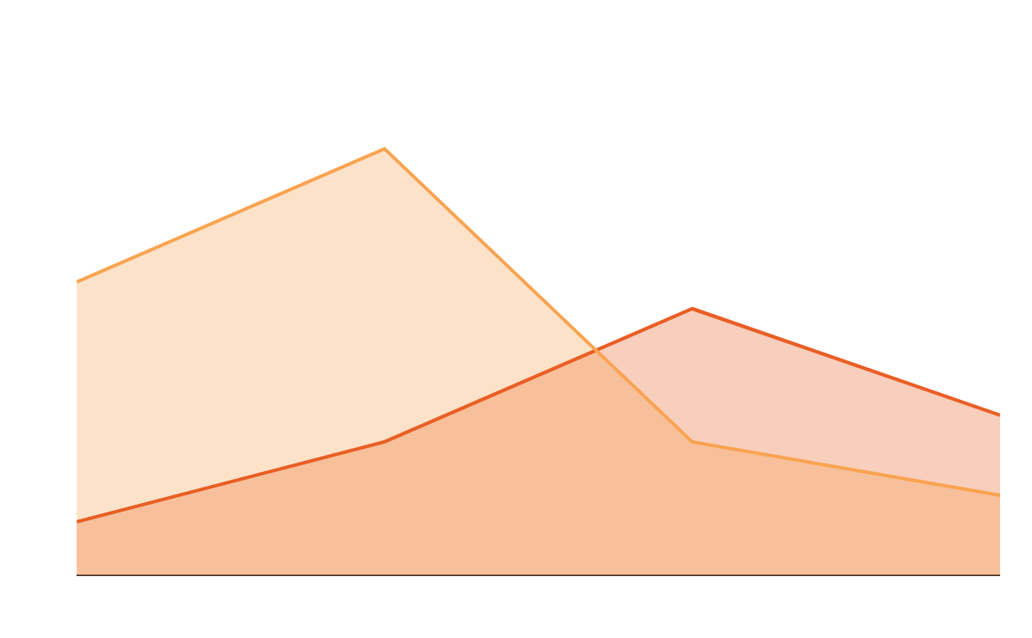
BASKETBALL TRAINING CENTER
15%
Venus has a beautiful name
30%
Jupiter is a huge gas giant
Follow the link in the graph to modify its data and then paste the new one here. For more info, click here

Slide 20
BASKETBALL TRAINING CENTER
01
ABOUT JUPITER
YES
Jupiter is a huge gas giant
More data about basketball?
02
ABOUT EARTH
Earth harbors life
03
ABOUT VENUS
n
NO
Venus has a beautiful name

Slide 21
BASKETBALL TRAINING CENTER
JUPITER
MARS
Jupiter is a huge gas giant
Mars is actually a cold place
EARTH
SATURN
It’s a planet that harbors life
It was named after a god

Slide 22
BASKETBALL TRAINING CENTER
01
02
03
04
50%
90%
30%
15%
Jupiter is a huge gas giant
Venus has a beautiful name
Mars is actually a cold place
Earth is a planet that has life

Slide 23
BASKETBALL TRAINING CENTER
JUPITER
10%
RESULT
EARTH
45%
RESULT
MARS
80%
RESULT
SATURN
30%
RESULT

Slide 24
BASKETBALL TRAINING CENTER
A |  |  |  |  |  |  |  |  |  |  | 60% | Jupiter is the biggest planet of them all
B |  |  |  |  |  |  |  |  |  |  | 30% | Mercury is the closest planet to the Sun
C |  |  |  |  |  |  |  |  |  |  | 80% | Venus is the second planet from the Sun
D |  |  |  |  |  |  |  |  |  |  | 50% | Earth is the third planet from the Sun
E |  |  |  |  |  |  |  |  |  |  | 90% | Saturn is a gas giant and has rings
F |  |  |  |  |  |  |  |  |  |  | 10% | Mars is actually a very cold place

Slide 25
BASKETBALL TRAINING CENTER
 | ACTIVITY 1 | ACTIVITY 2 | ACTIVITY 3
Venus is the second planet from the Sun
Mars is actually a very cold place
Mercury is the closest planet to the Sun
Earth is the third planet from the Sun

Slide 26
BASKETBALL TRAINING CENTER
01
JUPITER
Jupiter is a huge gas giant
25%
02
VENUS
Venus has a beautiful name
37%
03
SATURN
Saturn has several rings
38%

Slide 27
BASKETBALL TRAINING CENTER
JUPITER
MERCURY
Jupiter is a huge gas giant
Mercury is a small planet
EARTH
SATURN
It’s the planet that has life
Saturn has several rings
VENUS
MARS
Venus has a beautiful name
Mars is actually a cold place

Slide 28
BASKETBALL TRAINING CENTER
01
TEAM
WON
Jupiter is a huge gas giant
59 points
02
TEAM
LOST
Venus has a beautiful name
50 points

Slide 29
BASKETBALL TRAINING CENTER
01
JUPITER
Jupiter is a huge gas giant
4/5
02
VENUS
Venus has a beautiful name
2/5
03
SATURN
Saturn was named after a god
5/5

Slide 30
BASKETBALL TRAINING CENTER
CONCLUSIONS
20%
80%
Mercury is the closest planet to the Sun and the smallest one in the entire Solar System. This planet's name has nothing to do with the liquid metal, since Mercury was named after the Roman messenger god. Mercury has no natural satellites
VENUS
JUPITER
12 million players in total!
Venus has a beautiful name
Jupiter is a huge gas giant

Slide 31
BASKETBALL TRAINING CENTER
OUR TEAM
KAREN
TOM
JIMMY
Jupiter is a huge gas giant
Venus has a beautiful name
Mars is actually a cold place
Center
Point guard
Small forward

Slide 32
BASKETBALL TRAINING CENTER
Mercury is the closest planet to the Sun and the smallest one in the entire Solar System
55%
70%
OPTION A
OPTION C
Despite being red, Mars is actually a cold place
Neptune is the farthest planet from the Sun
35%
20%
OPTION B
OPTION D
Jupiter is the biggest planet of them all
Saturn is composed of hydrogen and helium
A | B | C | D

Slide 33
Instructions for use
If you have a free account, in order to use this template, you must credit Slidesgo in your final presentation. Please refer to the next slide to read the instructions for premium users.
As a Free user, you are allowed to:
- Modify this template.
- Use it for both personal and commercial projects.
You are not allowed to:
- Sublicense, sell or rent any of Slidesgo Content (or a modified version of Slidesgo Content).
- Distribute Slidesgo Content unless it has been expressly authorized by Slidesgo.
- Include Slidesgo Content in an online or offline database or file.
- Offer Slidesgo templates (or modified versions of Slidesgo templates) for download.
- Acquire the copyright of Slidesgo Content.
For more information about editing slides, please read our FAQs or visit our blog:
https://slidesgo.com/faqs and https://slidesgo.com/slidesgo-school

Slide 34
Instructions for use (premium users)
As a Premium user, you can use this template without attributing Slidesgo.
You are allowed to:
Modify this template.
Use it for both personal and commercial purposes.
Hide or delete the “Thanks” slide and the mention to Slidesgo in the credits.
Share this template in an editable format with people who are not part of your team.
You are not allowed to:
Sublicense, sell or rent this Slidesgo Template (or a modified version of this Slidesgo Template).
Distribute this Slidesgo Template (or a modified version of this Slidesgo Template) or include it in a database or in any other product or service that offers downloadable images, icons or presentations that may be subject to distribution or resale.
Use any of the elements that are part of this Slidesgo Template in an isolated and separated way from this Template.
Register any of the elements that are part of this template as a trademark or logo, or register it as a work in an intellectual property registry or similar.
For more information about editing slides, please read our FAQs or visit our blog:
https://slidesgo.com/faqs and https://slidesgo.com/slidesgo-school

Slide 35
Infographics
You can add and edit some infographics to your presentation to present your data in a visual way.
Choose your favourite infographic and insert it in your presentation using Ctrl C + Ctrl V or Cmd C + Cmd V in Mac.
Select one of the parts and ungroup it by right-clicking and choosing “Ungroup”.
Change the color by clicking on the paint bucket.
Then resize the element by clicking and dragging one of the square-shaped points of its bounding box (the cursor should look like a double-headed arrow). Remember to hold Shift while dragging to keep the proportions.
Group the elements again by selecting them, right-clicking and choosing “Group”.
Repeat the steps above with the other parts and when you’re done editing, copy the end result and paste it into your presentation.
Remember to choose the “Keep source formatting” option so that it keeps the design. For more info, please visit our blog.

